Slide 1
Problem and Users Lightning Talk
sdmay25-26 Bryce Rega, Marek Jablonski, Gavin Patel, Jonah Frosch, Long Yu
October 8th, 2024

Slide 2
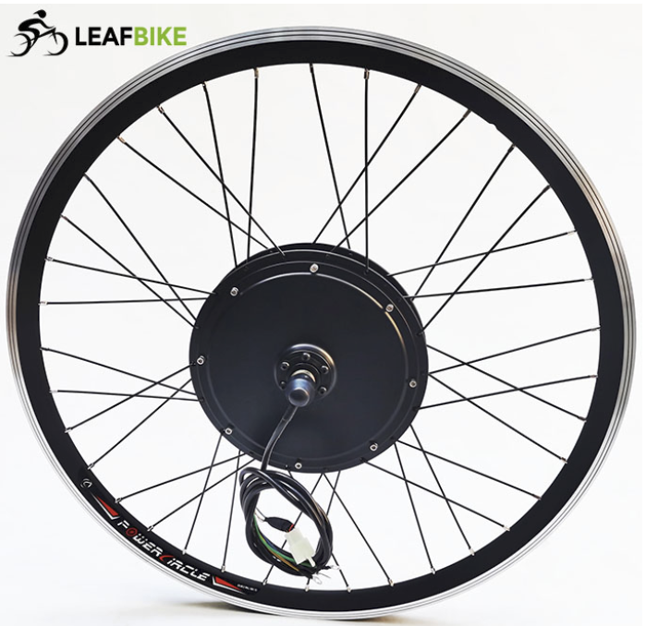
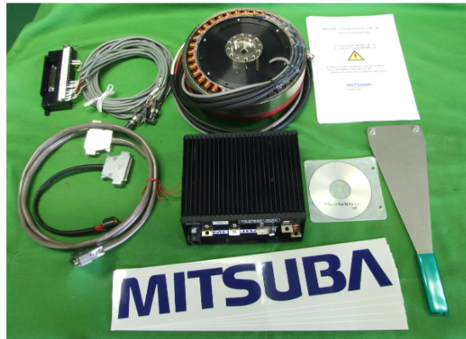
Project Overview
Custom High Voltage Motor Controller
Low Total cost for controller when compared to market options
Develop a GUI for interfacing and configuring controller
Compatible with many different applications

Slide 3
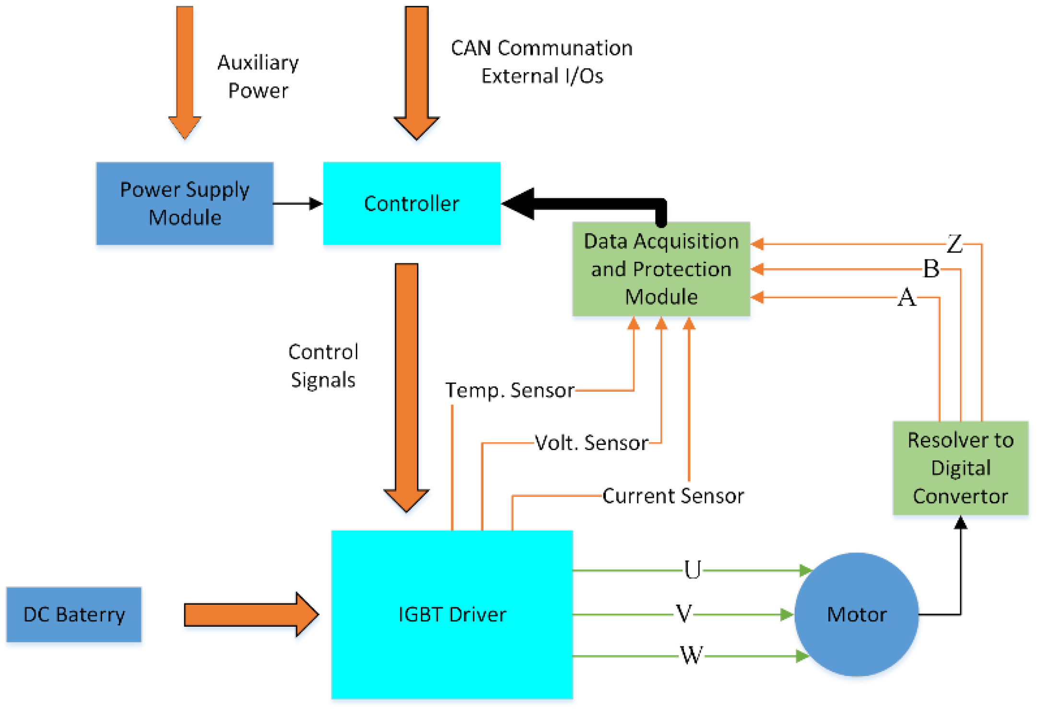
In this project will we be designing the architecture and implementation of a motor controller for lightweight automotive use.

Slide 4
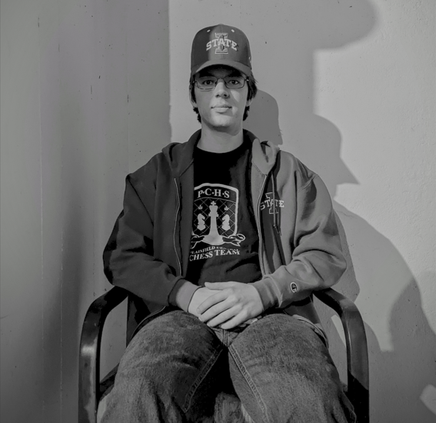
Personas
Jonah
Small Vehicle Engineers
Old Man McGee
Interested in bike electrification
Has prior knowledge about motor controllers
Needs inexpensive way to control small vehicle motors
Wants compatibility with different motor specs
Interested in personal motor usage
Generally unfamiliar with motor controllers, will require more guidance

Slide 5
Personas' Needs
Jonah
Small Vehicle Engineers
Old Man McGee
Needs high power output
Needs a reliable controller that will function for long distances
Needs thorough documentation
Needs telemetry data to read off of and test motors
Needs the usage and installation to be simple
Needs clear and intelligible documentation

Slide 6
Conclusion
We aim to develop a motor controller that applies to multiple applications. We intend to make this lightweight motor controller affordable, easy to use and adapt, and have plug-in diagnostics for troubleshooting. By doing all of these we intend to make an alternative to the available products while exploiting gaps in the market.

